Slide 1


Virtual Assistant
Project Guide:
Prof. Kumar Parmar
Rutvik Bhatti – 91900104005

Slide 2
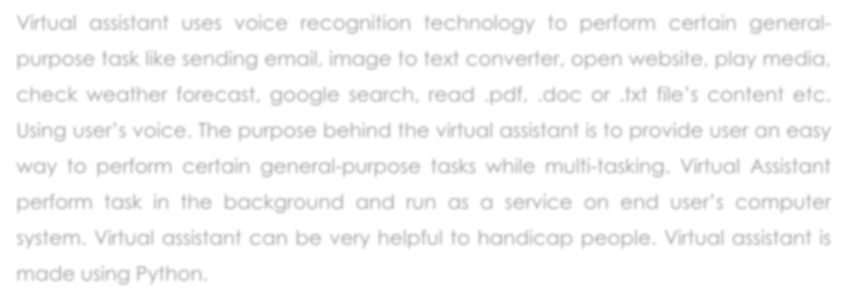
Abstract
Virtual assistant uses voice recognition technology to perform certain general- purpose task like sending email, image to text converter, open website, play media, check weather forecast, google search, read .pdf, .doc or .txt file’s content etc. Using user’s voice. The purpose behind the virtual assistant is to provide user an easy way to perform certain general-purpose tasks while multi-tasking. Virtual Assistant perform task in the background and run as a service on end user’s computer system. Virtual assistant can be very helpful to handicap people. Virtual assistant is made using Python.

Slide 3
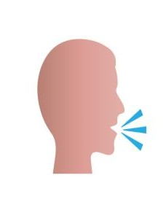

Functionality & background Work
Recognize s Human Speech
Handle Text Input
Process Logic
Perform
STT
Desired Output as Visual / Voice

Slide 4



Users of Project
🞅 End User

Slide 5

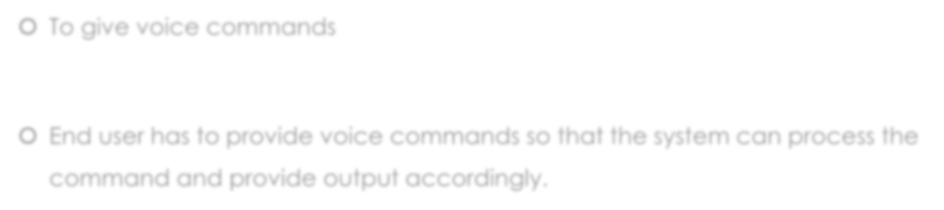
Roles of users
🞅 To give voice commands
🞅 End user has to provide voice commands so that the system can process the command and provide output accordingly.

Slide 6
Technology and Methodology
Python with Agile Methodology

Slide 7
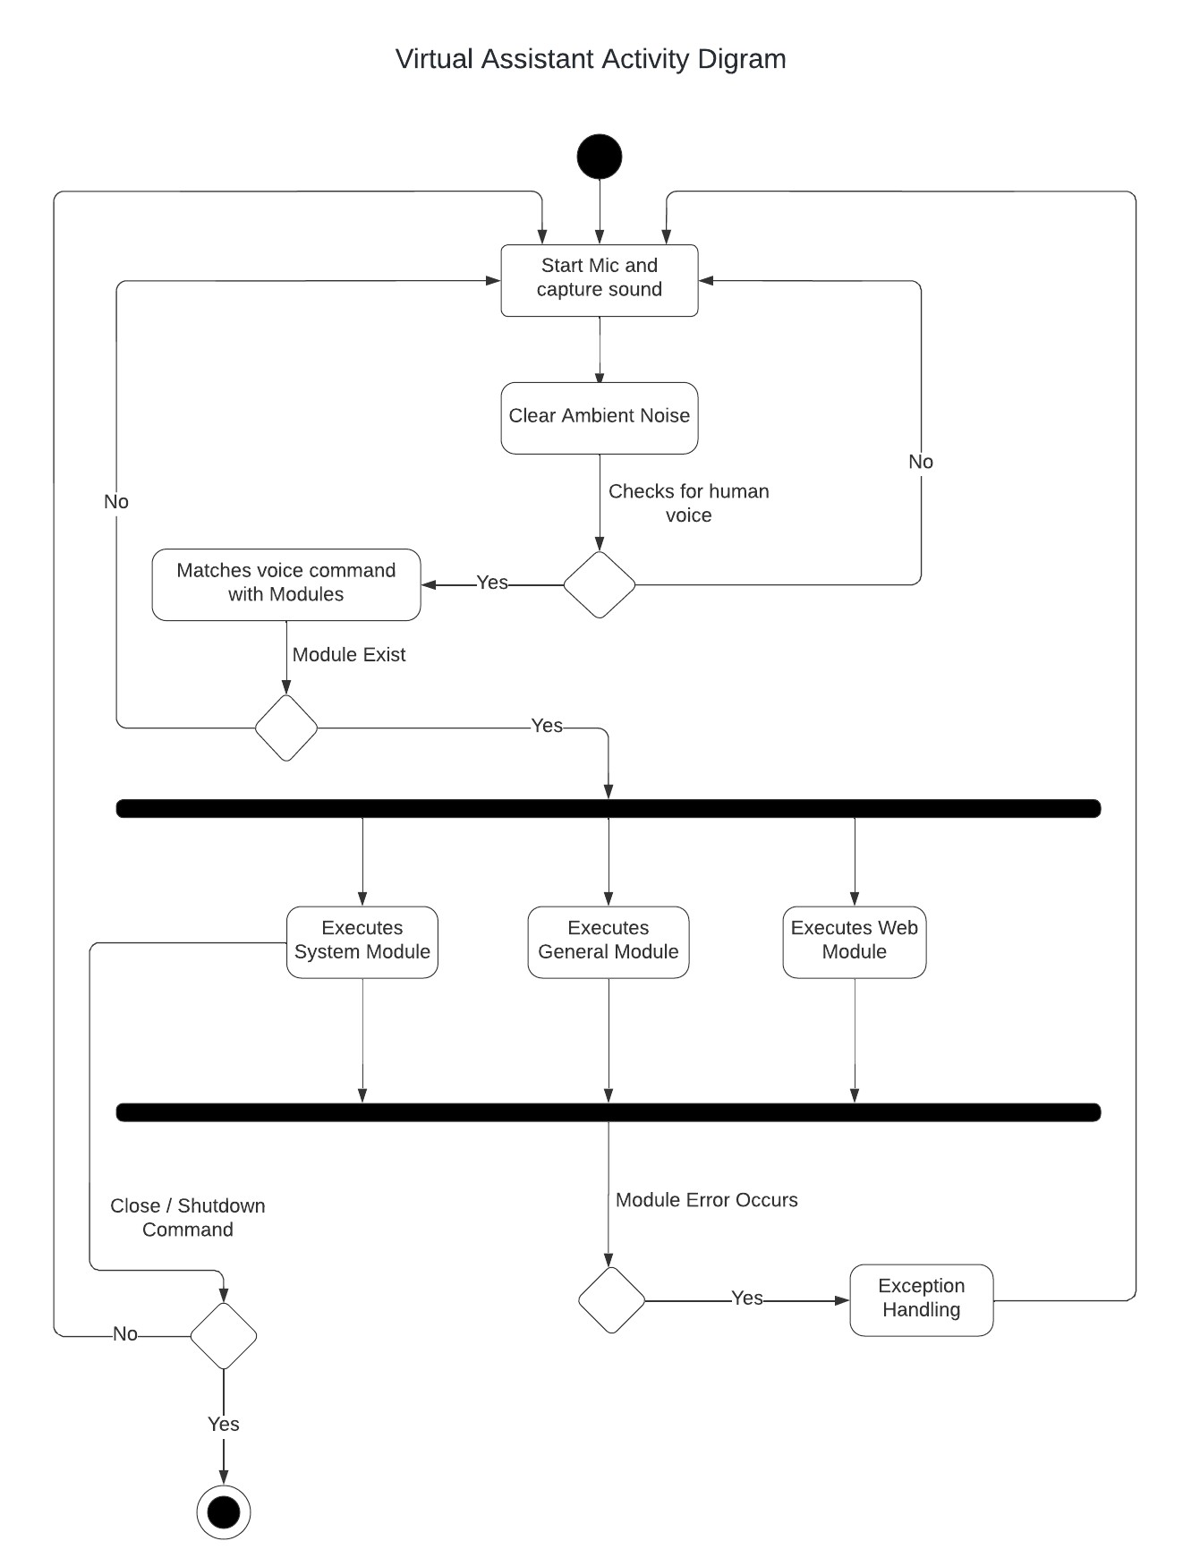

Slide 8
UML Diagram

Slide 9
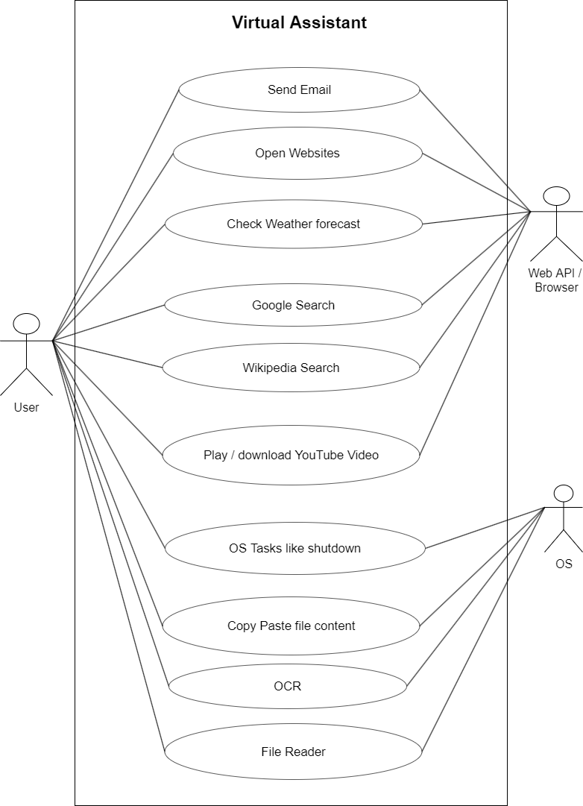

Slide 10

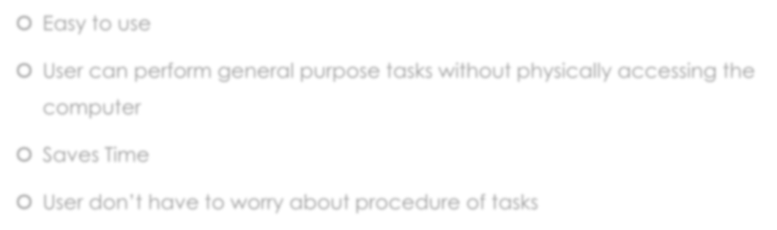
Advantages
🞅 Easy to use
🞅 User can perform general purpose tasks without physically accessing the
computer
🞅 Saves Time
🞅 User don’t have to worry about procedure of tasks

Slide 11


Requirements
🞅 Decent Mic Required
🞅 Clear Surrounding Required

Slide 12
References for background work
[1] G. O. Young, “Synthetic structure of industrial plastics (Book style with paper title and editor),” in Plastics, 2nd ed. vol. 3, J. Peters, Ed. New York: McGraw-Hill, 1964, pp. 15–64.
[2] W.-K. Chen, Linear Networks and Systems (Book styl\e).Belmont, CA: Wadsworth, 1993, pp. 123–135.
[3] H. Poor, An Introduction to Signal Detection and Estimation. New York: Springer-Verlag, 1985, ch. 4.
[4] B. Smith, “An approach to graphs of linear forms (Unpublished work style),” unpublished.
[5] E. H. Miller, “A note on reflector arrays (Periodical style—Accepted for publication),” IEEE Trans. Antennas Propagat., to be published.

Slide 13

THANK YOU

